Slide 1


YESHWANTRAO CHAVAN COLLEGE OF ENGINEERING
Department of Computer Technology
PQAI-2 Seminar on
Advanced monitoring and control mechanism for electric vehicle charging station using Machine learning
PRESENTED BY: CT-23
Vedika Peshane - 31
Aditya Bhone - 39
Atharva Pophali - 47
Atharva Fukey - 48
Hariom Balang - 57
Kiran Wande - 103
SECTION : A
YEAR: 2025-26
COLLEGE GUIDE:
Prof.N.U.Sambhe
INDUSTRIAL Co-guide :
Prof.P.S.Shete, EL Dept

Slide 2
Department Vision and Mission
Vision
To be a well-known center for pursuing computer education through innovative pedagogy, value-based education and industry collaboration.
Mission
To establish learning ambience for ushering in computer engineering professionals in core and multidisciplinary arena by developing problem-solving skills through emerging technologies.

Slide 3
Program Outcomes/Program Specific Outcomes
At the end of Program, Graduate students will have
PO1: Engineering Knowledge: Apply knowledge of mathematics, natural science, computing, engineering fundamentals and an engineering specialization as specified in WK1 to WK4 respectively to develop to the solution of complex engineering problems.
PO2: Problem Analysis: Identify, formulate, review research literature and analyze complex engineering problems reaching substantiated conclusions with consideration for sustainable development. (WK1 to WK4)
PO3: Design/Development of Solutions: Design creative solutions for complex engineering problems and design/develop systems/components/processes to meet identified needs with consideration for the public health and safety, whole-life cost, net zero carbon, culture, society and environment as required. (WK5)
PO4: Conduct Investigations of Complex Problems: Conduct investigations of complex engineering problems using research-based knowledge including design of experiments, modelling, analysis & interpretation of data to provide valid conclusions. (WK8).
PO5: Engineering Tool Usage: Create, select and apply appropriate techniques, resources and modern engineering & IT tools, including prediction and modelling recognizing their limitations to solve complex engineering problems. (WK2 and WK6)
PO6: The Engineer and The World: Analyze and evaluate societal and environmental aspects while solving complex engineering problems for its impact on sustainability with reference to economy, health, safety, legal framework, culture and environment. (WK1, WK5, and WK7).

Slide 4
Program Outcomes/Program Specific Outcomes
PO7: Ethics: Apply ethical principles and commit to professional ethics, human values, diversity and inclusion; adhere to national & international laws. (WK9).
PO8: Individual and Collaborative Team work: Function effectively as an individual, and as a member or leader in diverse/multi-disciplinary teams.
PO9: Communication: Communicate effectively and inclusively within the engineering community and
society at large, such as being able to comprehend and write effective reports and design documentation, make effective presentations considering cultural, language, and learning differences
PO10: Project Management and Finance: Apply knowledge and understanding of engineering
management principles and economic decision-making and apply these to one’s own work, as a member and leader in a team, and to manage projects and in multidisciplinary environments.
PO11: Life-Long Learning: Recognize the need for, and have the preparation and ability for i) independent and life-long learning ii) adaptability to new and emerging technologies
[PSO 1] An ability to acquire skills to design & develop quality software using cutting-edge technologies of Computer Engineering.
[PSO 2] An ability to use knowledge of various domains as per thrust areas to formulate and implement ideas for providing innovative solutions.

Slide 5
Course Outcomes
Course Outcomes | Program Outcomes |  |  |  |  |  |  |  |  |  |  | Program Specific Outcomes
 | 1 | 2 | 3 | 4 | 5 | 6 | 7 | 8 | 9 | 10 | 11 | PSO1 | PSO2
Identify a problem, analyze research gaps through a literature survey, and propose an ethical, innovative solution with societal impact. | 3 | 3 | 3 | 3 | 3 | 2 | 2 | 3 | 3 |  | 2 | 3 | 2
Develop a structured project report detailing the problem, methodology, proposed solution, and findings, adhering to professional and ethical standards. | 3 | 3 | 3 | 3 | 3 | 3 | 2 | 3 | 3 |  | 2 | 3 | 3
Implement a basic prototype/model to validate the proposed solution, demonstrating practical application of knowledge and technical skills. | 3 | 3 |  |  | 3 |  |  | 3 | 3 | 3 | 3 | 3 | 3
Avg | 3 | 3 | 3 | 3 | 3 | 2.5 | 2 | 3 | 3 | 3 | 2.3 | 3 | 2.6667

Slide 6
Contents
Problem Definition
Introduction
3.
Objectives
Work Done
Expected Input and Output
Status of Research Paper /Patent (If Any)
7.
References

Slide 7
Problem Statement
A Machine Learning system for EV charging stations that predicts optimal current, detects faults in real time, and optimizes operations for efficient and seamless charging.

Slide 8
Introduction
As electric vehicles (EVs) become an integral part of our daily lives, the need for smarter and more efficient charging infrastructure has never been greater. Charging stations must do more than just provide power they need to be reliable, adaptable, and capable of meeting growing demand while minimizing energy waste.
Our project tackles this challenge by creating a predictive model using a data-driven approach and supervised machine learning. By analyzing both historical and real-time data, the model can manage charging demand at charging stations, allowing energy to be distributed efficiently, reducing grid stress, and enhancing the user experience.
But it doesn’t stop there. The project also integrates advanced monitoring and control mechanisms, enabling real-time fault detection and better energy management. These features ensure charging stations remain efficient, safe, and capable of adapting to fluctuating energy loads and user needs.

Slide 9
Objective
Primary Objective/Problem Definition:
To design and develop a data-driven predictive model using supervised machine learning regression methods to accurately forecast charging demand at public charging stations, and to propose advanced monitoring and control mechanisms to optimize energy management, reduce peak demand, and enhance the overall charging experience.
Specific Objectives:
1.To Collect Dataset: Gather historical data on electric vehicle charging patterns, energy consumption, and other relevant factors to support predictive modeling
2.To design and develop model for Predictive analysis:Develop a machine learning-based predictive model that utilizes collected data to forecast charging demand and energy consumption.
3.To monitor and Predict: Design a real-time monitoring system that utilizes predictive analytics to forecast charging demand, detect anomalies, and optimize charging station operations.
4.To detect and manage fault: Develop a fault detection and management system that uses automated control mechanism to identify potential faults, alert operators, and provide recommendations for maintenance and repair

Slide 10
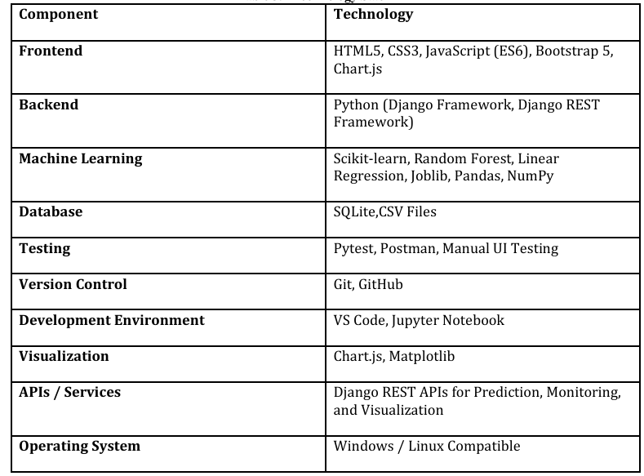
Tech Stack

Slide 11
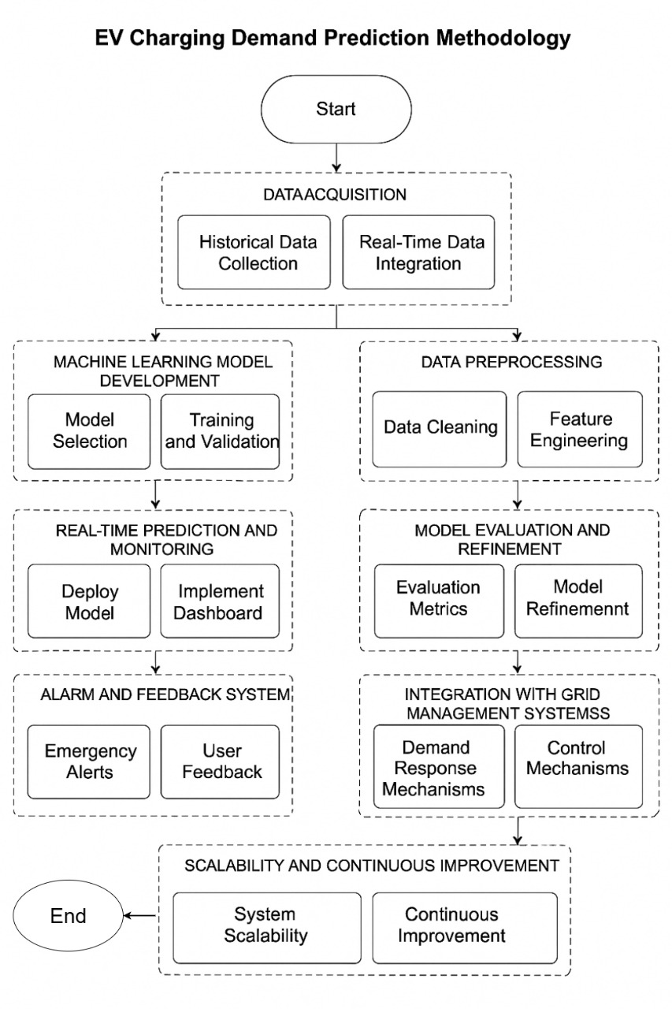
Work Done
1. System Design & Architecture
Designed a high-level architecture for data collection, processing, and decision-making.
Defined system components: sensors, cloud storage, ML model, and alert mechanism.
Developed block diagram and data flow models for implementation.
Developed Software Requirements Specification (SRS)
mbmhjb
i
Implement Dashboard

Slide 12
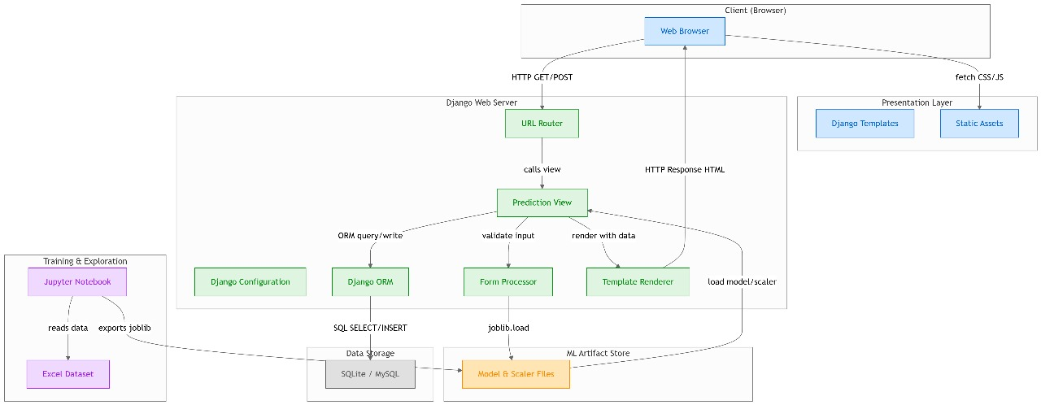
System Design & Architecture
This diagram shows actual technical implementation.

Slide 13
Work Done
The EVOptima system is built using Django and Python, divided into key modules that ensure smooth operation of all core functionalities — from prediction to monitoring and fault detection.
1. Energy Prediction Module • Takes input (Temperature, SOC, Duration, Timestamp) • Uses Random Forest, and Linear Regression for energy prediction • Displays predicted energy, voltage, and current
2. Fault Detection Module • Monitors voltage, current, and temperature in real time • Detects abnormal readings beyond thresholds • Logs and alerts faults on the dashboard
3. Threshold Management Module • Admin can modify safe operational limits for current, voltage, and temperature • Updates stored in database for live monitoring

Slide 14
Work Done
4. User Authentication Module • Secure login/signup using Django authentication • Restricts access to unauthorized users
5. Visualization Module • Uses Matplotlib for real-time and historical data graphs • Highlights faults visually with color-coded alerts
• Uses Chart.js, Matplotlib for real-time and historical data graphs
6. Real-Time Monitoring Module • Continuously updates live data (current, voltage, temperature, power) • Displays results with minimal delay for smooth performance

Slide 15

Expected Input and Output
Login window
This will allows only authorized personnel to access the system.
Increase system security.

Slide 16
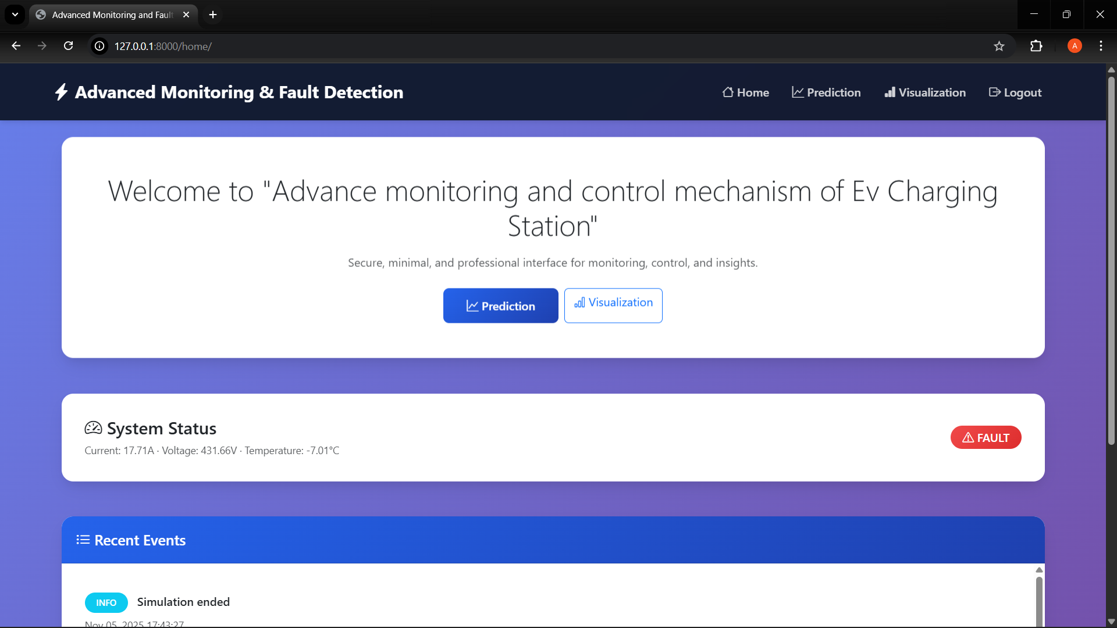
Expected Input and Output
Home screen :
After successful login user will redirect to home screen.
This pages shows
Welcome greeting
System status
Recent Events

Slide 17
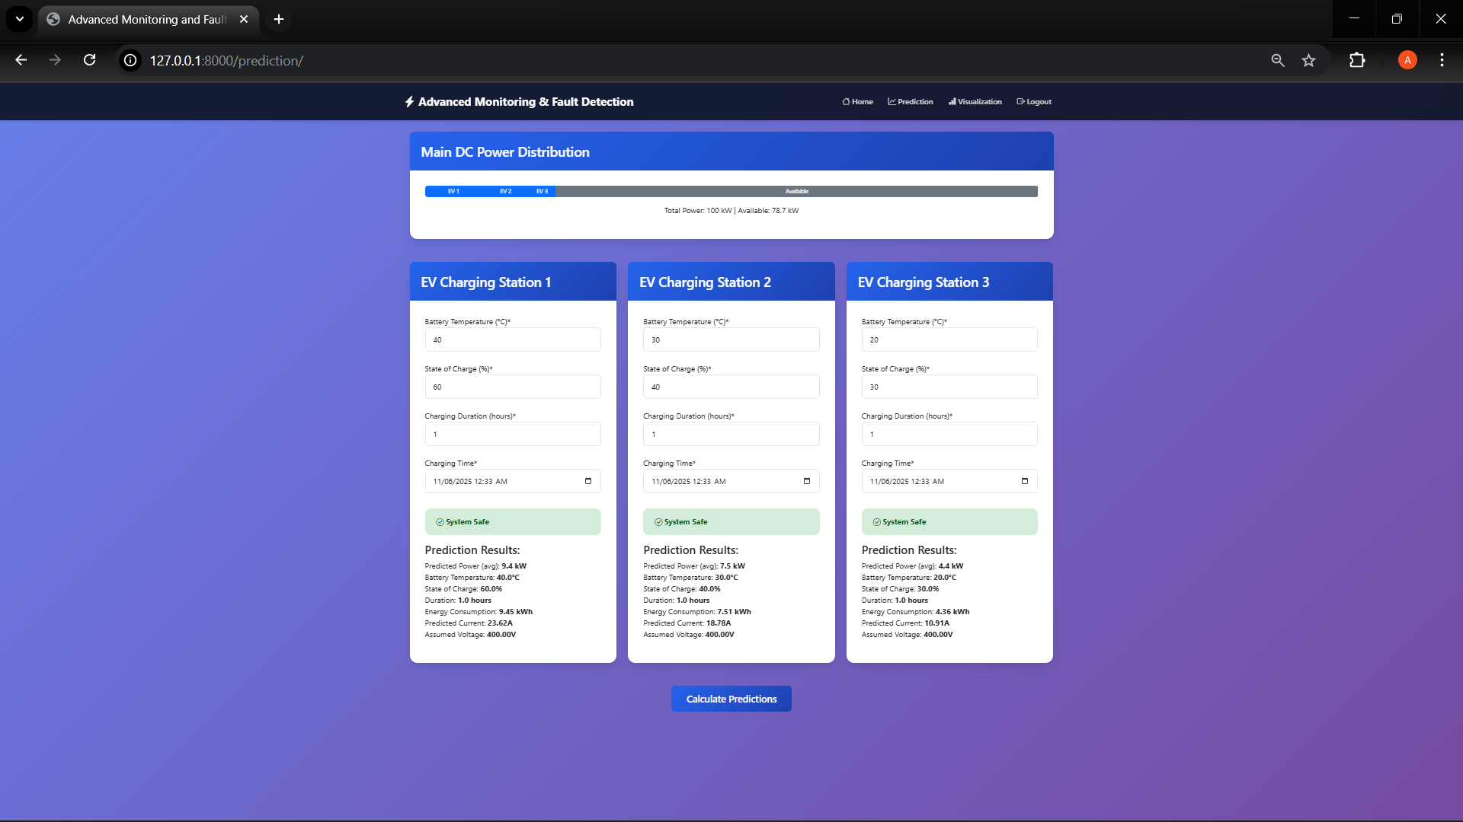
Expected Input and Output
Prediction Window :
Contains details about all charging points
Status of charging point
Display predicted value(current,power)
Total power consumption

Slide 18
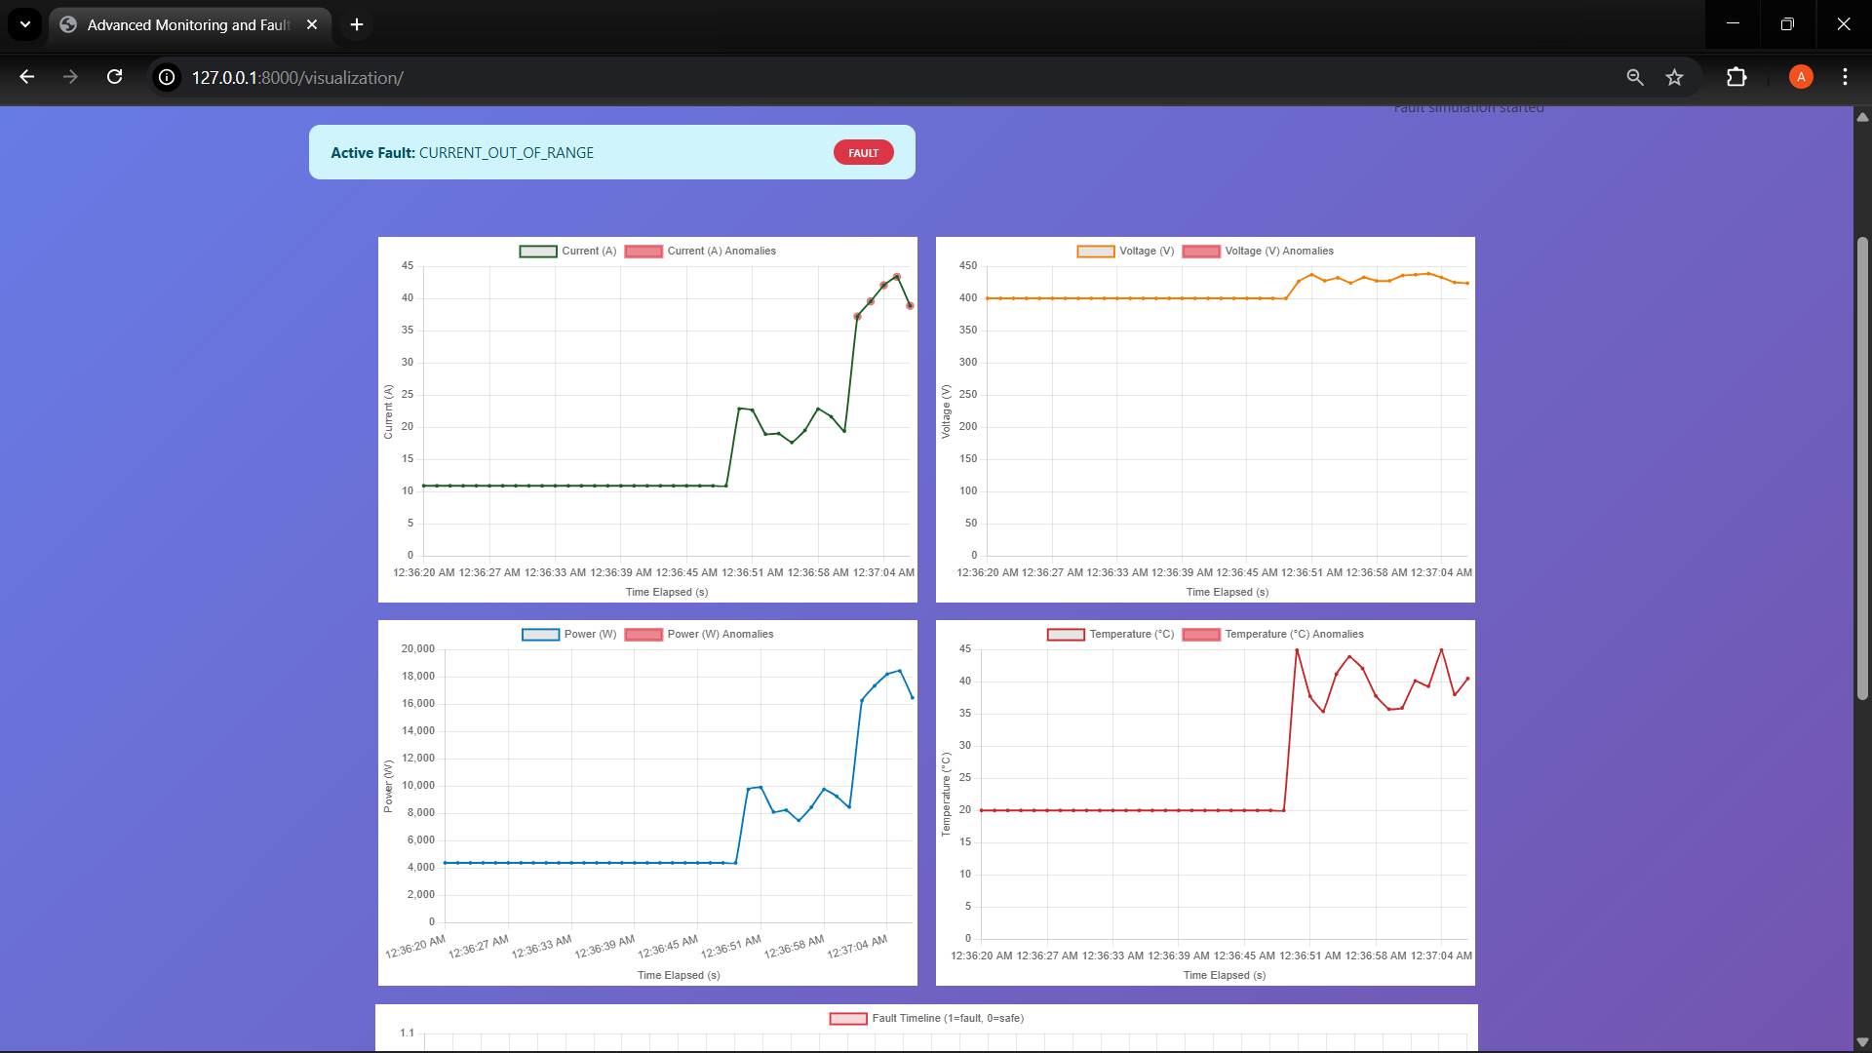
Expected Input and Output
Fault detection window :
This shows realtime fault detection.

Slide 19
Status of Research Paper /Patent
•Research Paper: Conference/Journal (*To be decided by Committee and Guide)
(*Note: POST - PROJECT SUBMISSION REQUIREMENT: : As mentioned earlier, the project titles and the scope of projects shall be such that at least ONE SCOPUS / WoS indexed publication / Book Chapter / Patent is derived out of the project work. The student has to pay the fees for publication. It shall clarify to all Project Guides and the project students that if the desired aim is not achieved before ESE Viva Voce of VII Sem ESE, the project may be extended to next SIX months and the final viva voce of project shall be conducted at the time of VIII Sem ESE.)

Slide 20
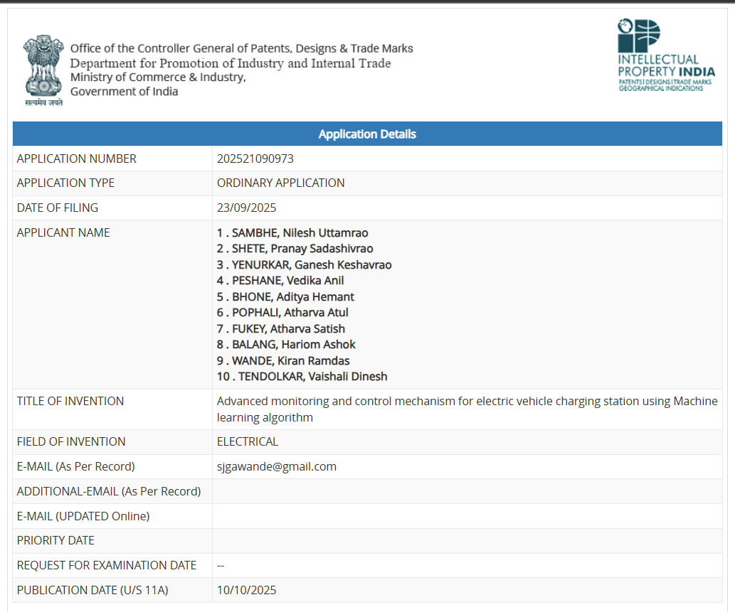
Patent
•Patent: Yes

Slide 21
References(*Strictly in IEEE format)
1.A. Almaghrebi, F. Aljuheshi, M. Rafaie, K. James, and M. Alahmad, “Data-Driven Charging Demand Prediction at Public Charging Stations Using Supervised Machine Learning Regression Methods,” Energies, vol. 13, no. 16, p. 4231, 2020. https://doi.org/10.3390/en13164231
2.S. Deb, “Machine Learning for Solving Charging Infrastructure Planning: A Comprehensive Review,” in Proc. 2021 IEEE Int. Conf. on Smart Grid and Smart Cities (ICSGSC), Tokyo, Japan, 2021, pp. 16–22. doi: 10.1109/ICSGSC52434.2021.9490407
3.Abu Shufian, N. Hannan, M. M. Hossain Emon, S. Kabir, S. A. Fattah, and M. S. Hossain, “Automatic Fault Detection and Analysis of Electric Vehicle Charging Station by Machine Learning,” in Proc. 2024 IEEE Region 10 Symposium (TENSYMP), 2024, pp. 1–6. doi: 10.1109/TENSYMP61132.2024.10752256.
4.Meiyi Huo, S. Pang, H. Bai, W. Li, M. Xu, and T. Liu, "Data-Driven Short-Term Electric Vehicle Charging Station Demand Forecasting," in Proc. 2024 IEEE CIEEC, pp. 1–5, 2024.
5.A. Palaniappan, P. Bhukya, S.K. Chitti, and J. Gao, “Data-Driven Analysis of EV Energy Prediction and Planning of EV Charging Infrastructure,” in Proc. 2023 IEEE Big Data Service and Applications, Athens, Greece, 2023, pp. 17–24. doi: 10.1109/BigDataService58306.2023.00009

Slide 22
References(*Strictly in IEEE format)
6.Prashanth Rajagopalan and Prakash Ranganathan, “Electric Vehicle Charging Behavior Prediction using Machine Learning Models,” in Proc. 2022 IEEE Electrical Power and Energy Conf. (EPEC), 2022, pp. 1–5
7.H. S. Hareshma and S. P. Sivraj, “Design and Development of Smart Charging Infrastructure for Electric Vehicles,” Proc. 2023 4th Int. Conf. Energy, Power and Environment (ICEFEET), 2023, pp. 1–6.
8.A. Lilhore, K. Kiran Prasad, and V. Agarwal, “Machine Learning-based Electric Vehicle User Behavior Prediction,” in Proc. 2023 IEEE Global Conference on Renewable Energy (GLOBCONHT), 2023, pp. 1–6
9.M. Straka, R. Carvalho, G. van der Poel, and U. Buzna, “Analysis of Energy Consumption at Slow Charging Infrastructure for Electric Vehicles,” IEEE Access, vol. 9, pp. 49362–49374, 2021. doi: 10.1109/ACCESS.2021.3071180
10.S. M. S and R. Gunabalan, “Enhancement of Charging Efficiency of Batteries for Electric Vehicles: Review,” in Proc. 2022 Fourth Int. Conf. on Emerging Research in Electronics, Computer Science and Technology (ICERECT), Mandya, India, 2022, pp. 1–6. doi: 10.1109/ICERECT56837.2022.10060243
11.M. Shukla, D. K. Singh, A. Yadav, A. K. Singh, N. A. Jumaa, and A. Mohammed, “Optimizing Electric Vehicle Charging Station Placement in Urban Areas: A Data-Driven Approach,” in Proc. 2023 3rd Int. Conf. Advance Computing and Innovative Technologies in Engineering (ICACITE), Greater Noida, India, 2023, pp. 2835–2838. doi: 10.1109/ICACITE57410.2023.10183075

Slide 23
References(*Strictly in IEEE format)
12.F. Qiao and S. Lin, “Predicting Electrical Vehicle Charging Patterns at Public Charging Stations,” in Proc. 2024 Int. Conf.Big Data, AI and IoT Engineering (ICBAIE), 2024, pp. 1–8.
13.S. Shahriar, A. R. Al-Ali, A. H. Osman, S. Dhou, and M. Nijim, “Machine Learning Approaches for EV Charging Behavior:A Review,” IEEE Access, vol. 8, pp. 168980–168993, 2020. doi: 10.1109/ACCESS.2020.3023388
14.R. Atallah, N. Al-Dahabreh, M. A. Sayed, K. Sarieddine, M. Elhattab, M. Khabbaz, and C. Assi, “Quality of Service Evaluation and Forecast for EV Charging Based on Real-WorldData,” in Proc. 2023 19th Int. Conf. Wireless and Mobile Computing, Networking and Communications (WiMob), Montreal, QC, Canada, 2023, pp. 280–285. doi:10.1109/WiMob58348.2023.10187855
15.V. N. Karkaria, S. B. Abrish Aaditya, A. Karnadikar, P. B. Karandikar, and S. Joshi, "EV Charging Infrastructure Development Using Machine Learning," in Proc. 2023 Int. Conf.Emerging Computing and Automation (ICECA), 2023, pp. 1–6.
16.D. Adhya, A. K. Chakraborty, A. Pal, and A. Bhattacharya, “Machine Learning Application for Prediction of EV Charging Demand for the Scenario of Agartala, India,” Proc. 2022 IEEEInt. Conf. Electrical Power and Energy Systems (ICEPE), pp. 1–6, 2022.

Slide 24
References(*Strictly in IEEE format)
17.M. Chendeb EL Rai, S. Abdul Hadi, H. Abu Damis, and A. Gawanmeh, “Prediction of Electric VehicleCharging Stations Distribution Using Machine Learning,” in Proc. 2022 5th Int.Conf. Signal Processing andInformation Security (ICSPIS), 2022, pp. 1–6. doi: 10.1109/ICSPIS57063.2022.10002556.
18.H. Li, J. Zhu, Y. Zhou, D. Feng, K. Zhang, and B. Shen, “Review of Load Forecasting Methods for ElectricVehicle Charging Station,” in Proc. 2022 IEEE IAS Industrial and Commercial Power System Asia, pp. 1–8,2022.
19.K. H. Akhil, K. Deepa, S.V. Tresa Sangeetha, and N. Neelima, "Prediction of Battery Failure in EVs UsingMachine Learning: A Case Study," 2024 Int. Conf. Knowledge Engineering and Communication Systems(ICKECS), pp. 1–7, 2024. doi: 10.1109/ICKECS61492.2024.10617051.
20.K. N. B. S. Hitesh, P. Saran Teja, and J. Ram Kumar, “Electric Vehicle Charging Demand Prediction usingMachine Learning Algorithms,” in Proc. 2024 8th Int. Conf. Inventive Systems and Control (ICISC), 2024, pp.1–7. doi: 10.1109/ICISC62624.2024.00015.

Slide 25
T
Thank You

